Slide 1
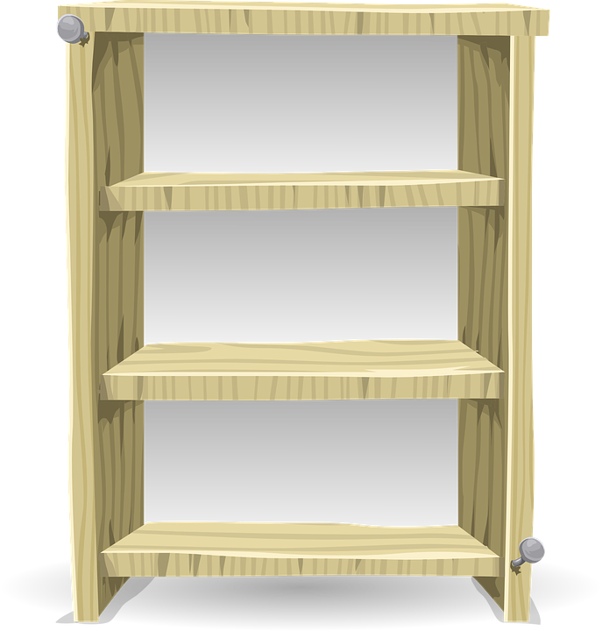
Chicod Media Center
I’m Ms. Williams, click here to read about me.
SORA
Sora Directions
I’m Mrs.Jones, click here to read about me.
MBOB
EBOB
Destiny Catalog

